Slide 1

C Programming
Week 07 21.12.07. 07:30 PM
Second-half period / CMD-C_Programming Study
Mentor : Jh9892

Slide 2
INDEX
INDEX
🔥C Language - Dynamic Memory Handling
🔥C Language – Structure Pointer

Slide 3
Dynamic Memory Handling
동적 메모리 할당
malloc()
calloc()
realloc()
free()

Slide 4
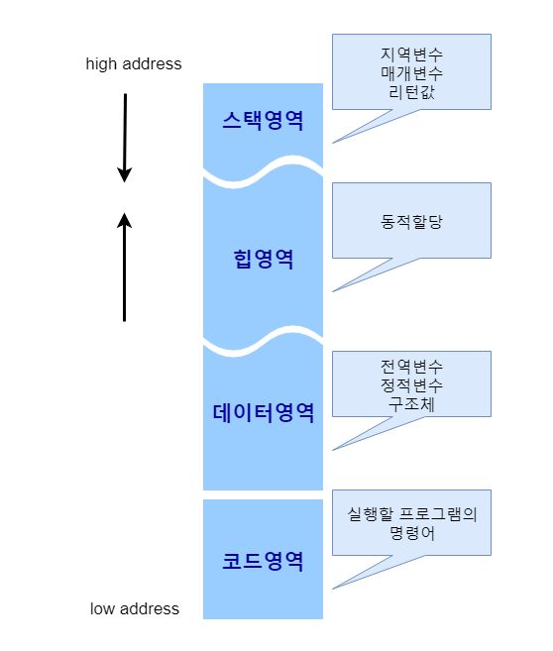
Dynamic Memory Handling
메모리 구조 ▶

Slide 5
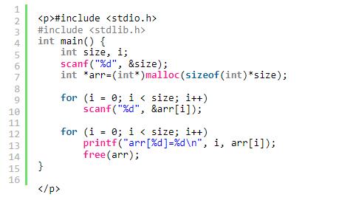
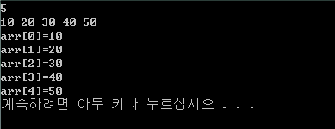
Dynamic Memory Handling
# include <stdlib.h>
void *malloc(size_t size);
void free(void *ptr);

Slide 6
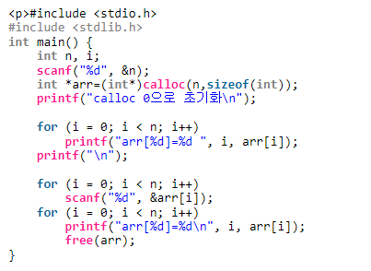
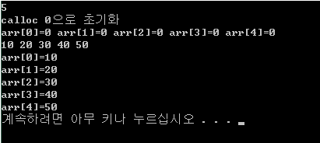
Dynamic Memory Handling
# include <stdlib.h>
void *calloc(size_t n, size_t size);
void free(void *ptr);

Slide 7
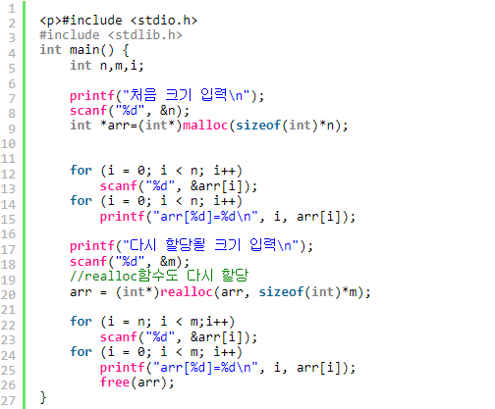
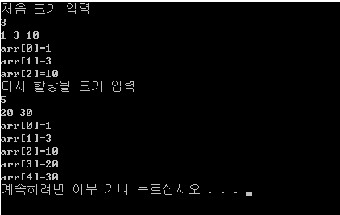
Dynamic Memory Handling
# include <stdlib.h>
void *realloc(void *memblock, size_t size);
void free(void *ptr);

Slide 8
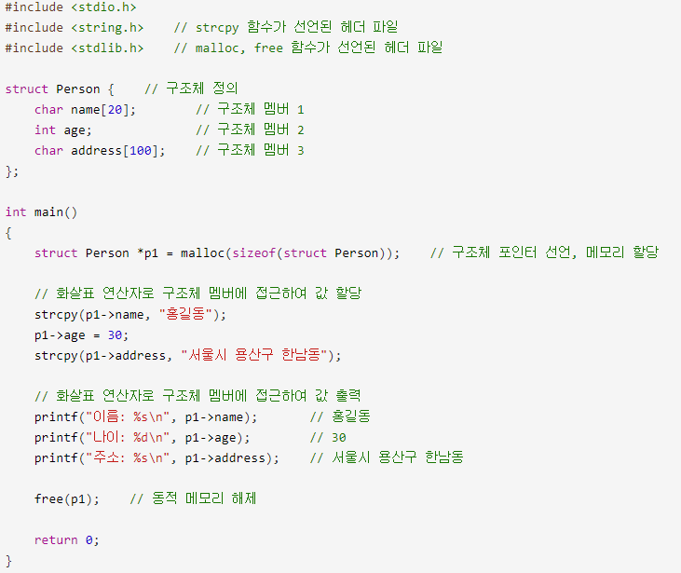
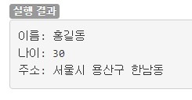
Structure Pointer

Slide 9
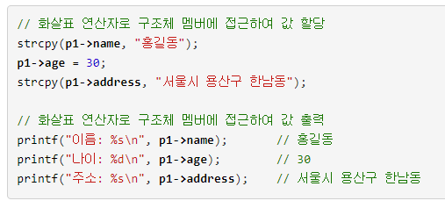
Structure Pointer

Slide 10
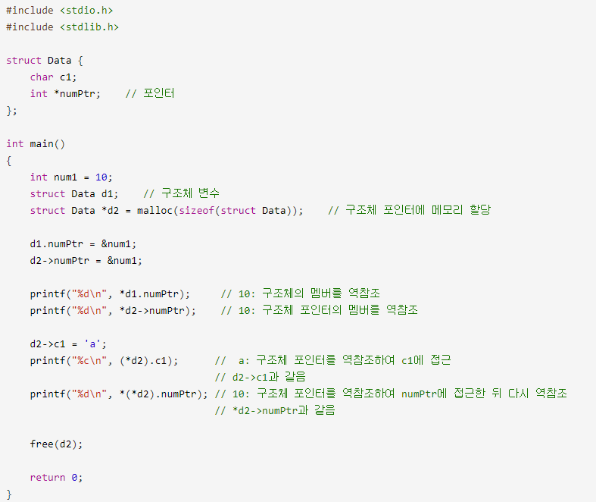
Structure Pointer

Slide 11
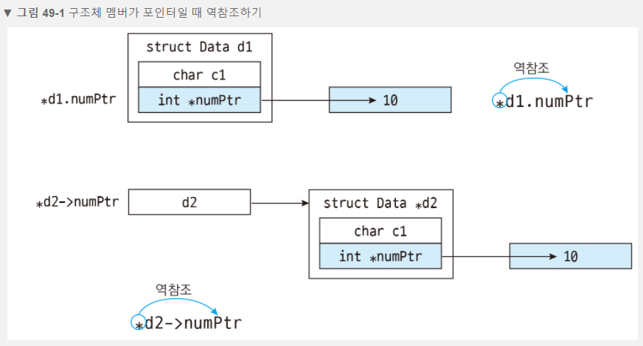
Structure Pointer

Slide 12
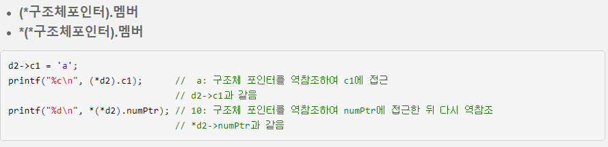
Structure Pointer

Slide 13
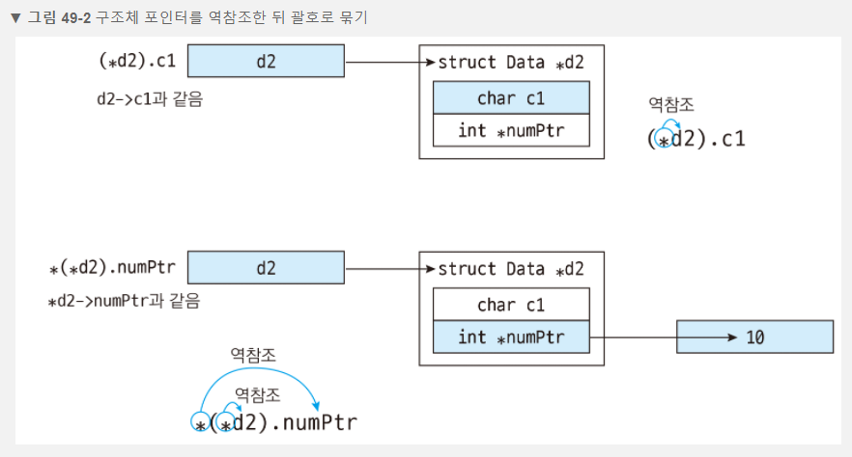
Structure Pointer

Slide 14
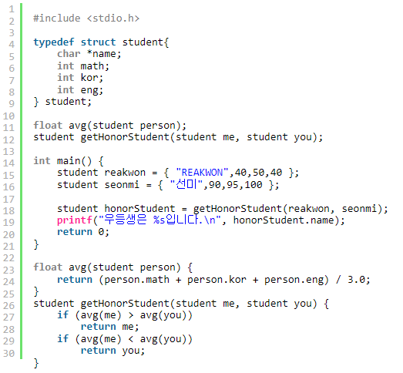
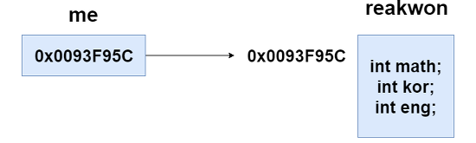
Structure Pointer

Slide 15
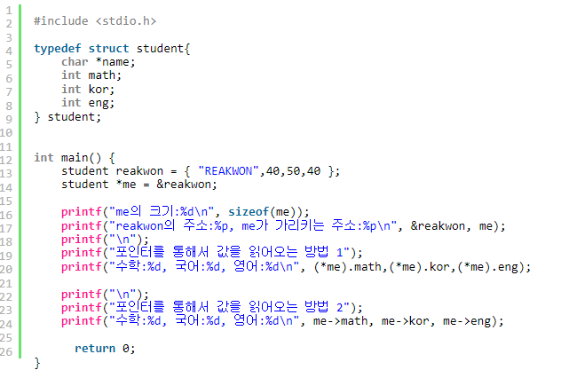
Structure Pointer

Slide 16
- Finish -

